Slide 1
Temporal Contrastive Pre-Training for Sequential Recommendation
Source : CIKM’22
Speaker : yang-YI, LIN
Advisor : Jia-Ling, Koh
Date : 2022/12/13

Slide 2
Outline
Introduction
Method
Experiment
Conclusion

Slide 3
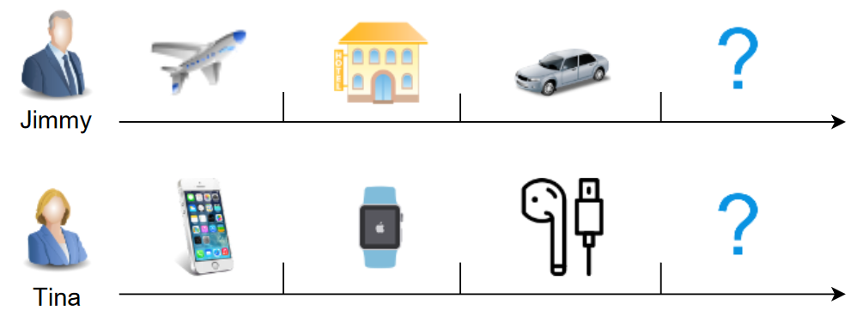
Introduction
Sequential Recommendation
Sequential dependencies
Capture the recent preference

Slide 4
Introduction
Sequential Recommendation
Markov Chains (MCs)
Recurrent Neural Networks (RNNs)
Self-attention based sequential model (SASRec)

Slide 5
Introduction
Motivation
Temporal Contrastive Pre-Training for Sequential Recommendation

Slide 6
Introduction
Temporal properties
Invariance(不變性) ：preference are relatively stable over a time period
Periodicity(週期性) ：preference are periodically recurrent

Slide 7
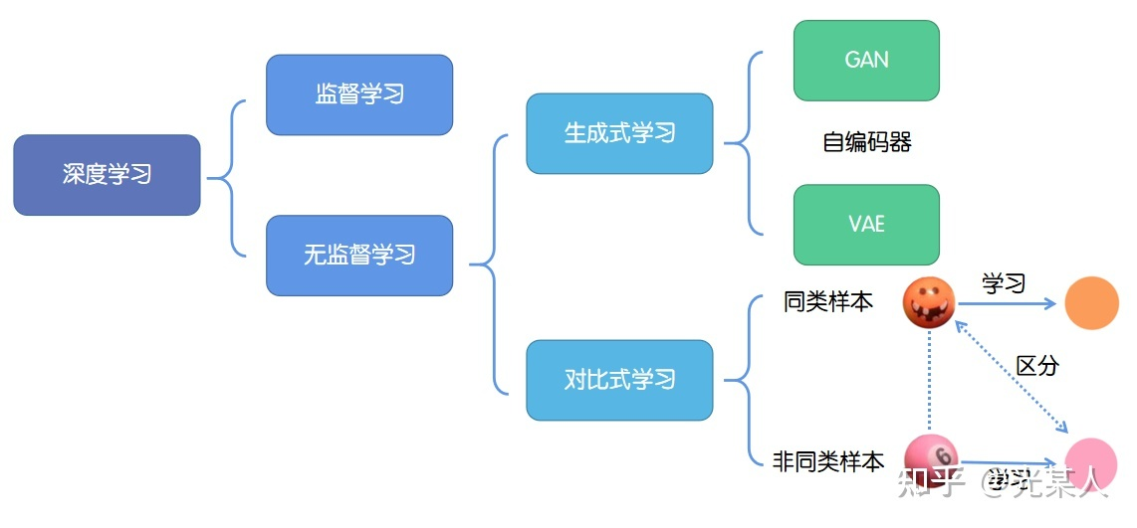
Introduction
Temporal Contrastive Pre-Training for Sequential Recommendation
Contrastive Learning

Slide 8
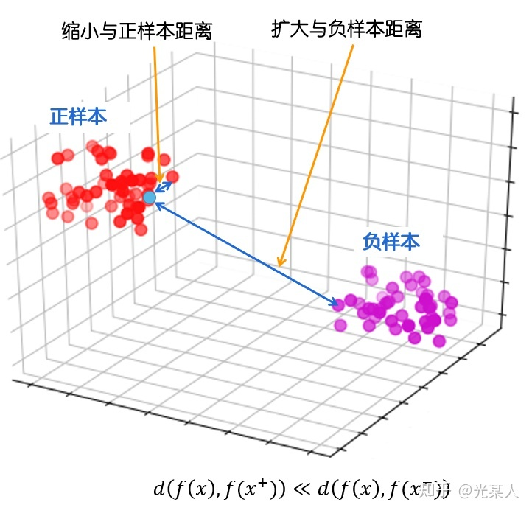
Introduction
Temporal Contrastive Pre-Training for Sequential Recommendation
Contrastive Learning
embedding space

Slide 9
Method
Self-attention based sequential model (SASRec)
Temporal Contrastive Pre-training
Fine-tuning

Slide 10
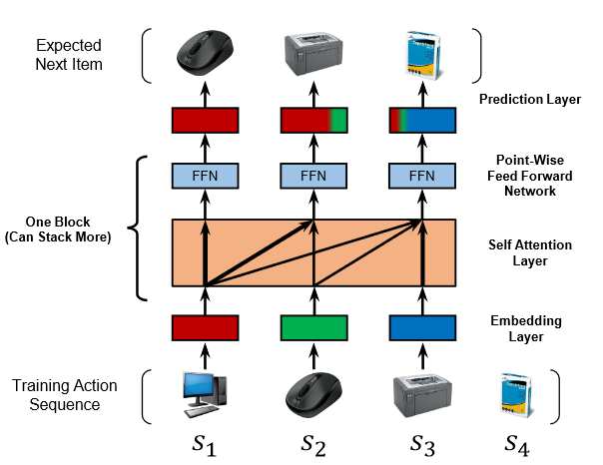
Method
Self-attention based sequential model (SASRec)
An embedding layer
Self-Attention layers -> Multi-head self-attention layers
point-wise feed-forward layers
A prediction Layer

Slide 11
Method
An embedding layer
Input：one-hot item representations
Output：$e_{i}$ ( item embedding matrix E ∈ $R^{|I|\text{×}\text{d}}$)

Slide 12
Method
Multi-head self-attention layers
Input：item embedding matrix E ∈ $R^{|I|\text{×}\text{d}}$
sum learnable position encoding matrix P ∈ $R^{\text{n}\text{×}\text{d}}$

Slide 13
Method
A point-wise feed-forward layer
Input：MultiHead ($H^{(l)}$)

Slide 14
Method
A prediction Layer
Input：$m_{t}$final representation of the item at step 𝑡
Output： user’s preference score for the item 𝑖 at the step (𝑡 + 1)

Slide 15
Method
Temporal Contrastive Pre-training
Invariance
global invariance within a sequence
local invariance within a subsequence
Periodicity
coarse-grained periodicity
fine-grained periodicity

Slide 16
Method
Global Invariant Modeling (Item Level)
the long-term preferences are reflected in all historical behaviors

Slide 17
Method
Local Invariant Modeling (Item Level)
the short-term preferences are reflected in each behavior subsequence

Slide 18
Method
Coarse-grained Periodicity Modeling (Subsequence Level)
the similar user intention recurs regularly

Slide 19
Method
Fine-grained Periodicity Modeling (Subsequence Level)
combining different periodicity patterns can yield more features

Slide 20
Method
Pre-training
𝜆1, 𝜆2, 𝜆3 and 𝜆4 are the hyper-parameters

Slide 21
Method
Fine-tuning

Slide 22
Experiment
8 baseline models & 6 dataset
Evaluation Metrics：
top-𝐾 metrics Hit Ratio (HR@𝐾)
Normalized Discounted Cumulative Gain (NDCG@𝐾)
K = 5, 10, 20

Slide 23
Experiment
Achieves the best performances on all datasets

Slide 24
Experiment
Ablation study

Slide 25
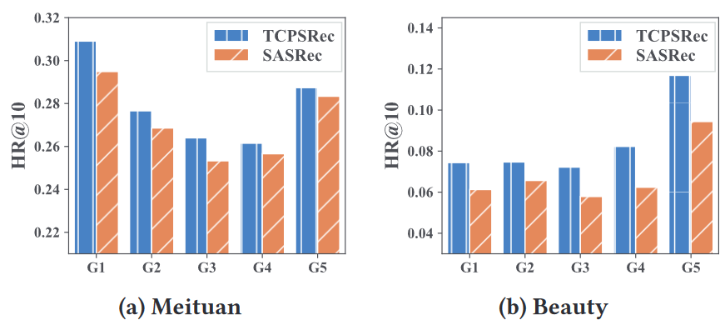
Experiment
Impact of data sparsity levels
𝐺5：the largest average number of interactions

Slide 26
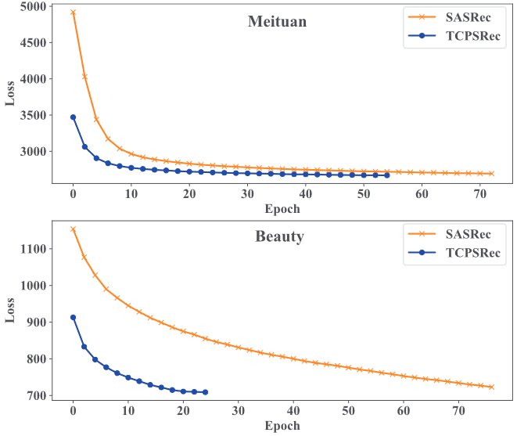
Experiment
Impact on the Convergence Speed
Applying the Pre-training Strategy on Other Models

Slide 27
Conclusion
Temporal contrastive pre-training approach by modeling invariance and periodicity.
Four specially designed contrastive learning objectives to better model temporal characteristics of user behaviors
Extensive experiments are conducted, demonstrating the effectiveness and generalization of our proposed method.

Slide 28
Normalized Discounted Cumulative Gain (NDCG)
Cumulative Gain (CG)
Discounted Cumulative Gain (DCG)
Normalized DCG (NDCG)
or
$\log_{2}\left(i+1\right)：$1, 1.585, 2, 2.322, 2.585, 2.807

